Slide 1
Execution Flow control

Slide 2
Relational and Logical Operators
A condition is an expression
Involving relational operators (such as < and >=)
Logical operators (such as and, or, and not)
Evaluates to either True or False
Conditions used to make decisions
Control loops
Choose between options

Slide 3
Relational Operators
Relational operator less than (<) can be applied to
Numbers
Strings
Other objects
For strings, the ASCII table determines order of characters

Slide 4
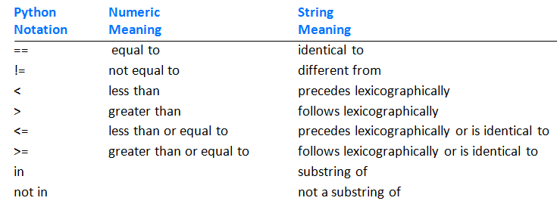
Relational Operators
Table 3.3 Relational operators.

Slide 5
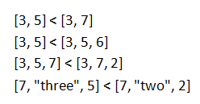
Relational Operators
Some rules
An int can be compared to a float.
Otherwise, values of different types cannot be compared
Relational operators can be applied to lists or tuples

Slide 6
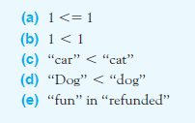
Relational Operators
Example 1: Determine whether following conditions evaluate to True or False

Slide 7
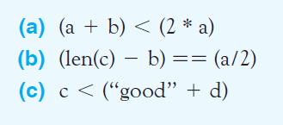
Relational Operators
Example 2: Determine whether following conditions evaluate to True or False

Slide 8
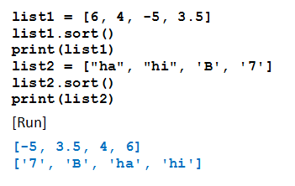
Sorting the Items in a List
Items in a list of items having same data type can be ordered with the sort method
Example 3: Program illustrates how Python orders two simple lists

Slide 9
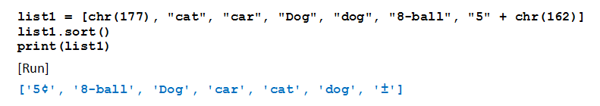
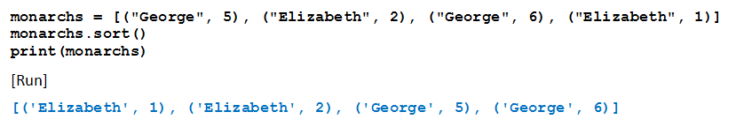
Sorting the Items in a List
Example 4: Items in a complicated list of strings.
Example 5: Items in a list of tuples

Slide 10
Logical Operators
Enables combining multiple relational operators
Logical operators are the reserved words and, or, and not
Conditions that use these operators are called compound conditions

Slide 11
Logical Operators
Given: cond1 and cond2 are conditions
cond1 and cond2 true only if both conditions are true
cond1 or cond2 true if either or both conditions are true
not cond1 is false if the condition is true, true if the condition is false

Slide 12
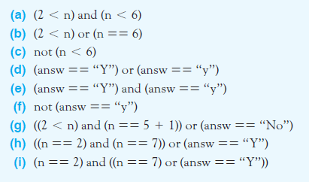
Logical Operators
Example 6: Given n = 4, answ = “Y” Determine expressions = True or False

Slide 13
Short-Circuit Evaluation
Consider the condition cond1 and cond2
If Python evaluates cond1 as false, it does not bother to check cond2
Similarly with cond1 or cond2
If Python finds cond1 true, it does not bother to check further
Think why this feature helps for (number != 0) and (m == (n / number))

Slide 14
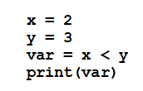

The bool Data Type
Objects True and False are said to have Boolean data type
Of data type bool.
What do these lines display?

Slide 15
Methods that Return Boolean Values
Given: strings str1 and str2
str1.startswith(str2)
str1.endswith(str2)
For determining the type of an item
isinstance(item, dataType)

Slide 16
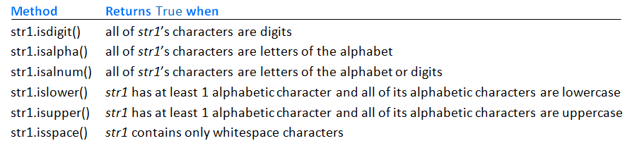
Methods that Return Boolean Values
Methods that return either True or False.
Table 3.4 Methods that return either True or False.

Slide 17
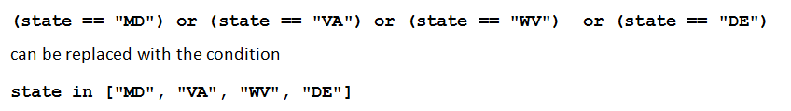
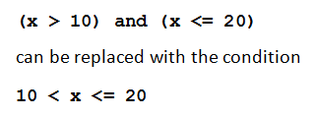
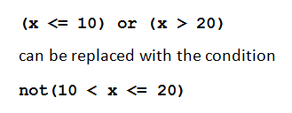
Simplifying Conditions
Lists or tuples can sometimes be used to simplify long compound conditions

Slide 18
Simplifying Conditions
Use of De Morgan’s Laws
not(cond1 and cond2) is the same as not(cond1) or not(cond2)
not(cond1 or cond2) is the same as not(cond1) and not(cond2)

Slide 19
END

